Slide 1



Data Cleaning in
SQL
By Laurids Klevenhaus

Slide 2


For this project I used MySQL and DBeaver to run queries

Slide 3

Data Brief
Nashville Housing Dataset – Data on houses in Nashville, US
This is the raw dataset containing 19 columns and 56.477 rows
1. UniqueID
2. ParcelID
3. LandUse
4. PropertyAddress
5. SaleDate
6. SalePrice
7. LegalReference
8. SoldAsVacant
9. OwnerName
10. OwnerAddress
11. Acreage
12. TaxDistrict
13. LandValue
14. BuildingValue
15. TotalValue
16. YearBuilt
17. Bedrooms
18. FullBath
19. HalfBath

Slide 4
Data Cleaning Process
1. Standardize Date Format; Change Date format to yyyy-mm-dd.
2. Populate Property Address Data; Fill in the blank data in the property address column by looking at the similarity of data in the ParcelID column.
3. Breaking Out Address Column; Split PropertyAddress column and OwnerAddress column into Address column, city column, and state column.
4. Replace Sold AS Vacant Data; Replace "Y" and "N" into "Yes" and "No".
5. Remove Duplicates; Removes duplicate records
6. Delete Unused Columns; Delete unused column such as PropertyAddress, OwnerAddress and SaleDate.

Slide 5

1. Standardize Date Format
Notes:
Issue: the date format was not standardized. So I needed to convert e.g. April 9, 2013 into year-month-day format like 2013-04-09

Slide 6
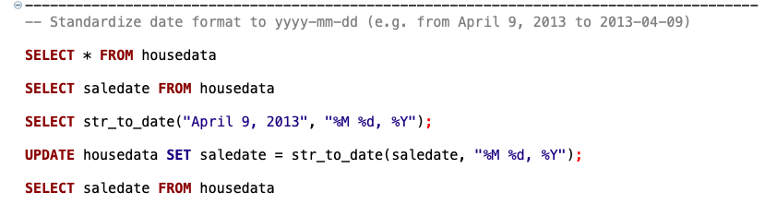
Solution

Slide 7
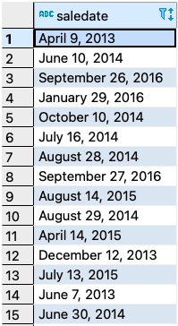
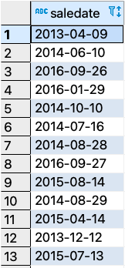
Solution
Before
After

Slide 8

2. Populate Property Address Data
Notes:
Issue: The “Property Address” column (not unique values btw) contained some null values / blanks despite the fact that the addresses were already known because the missing addresses had the same ParcelID as another instance where the address value was filled. So I needed to populate the blank addresses using the ParcelID that corresponded to that address.

Slide 9
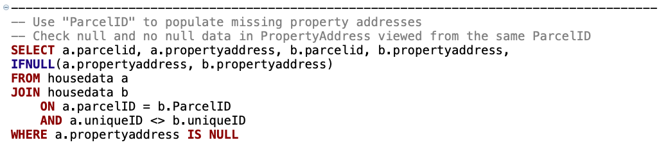
Solution

Slide 10
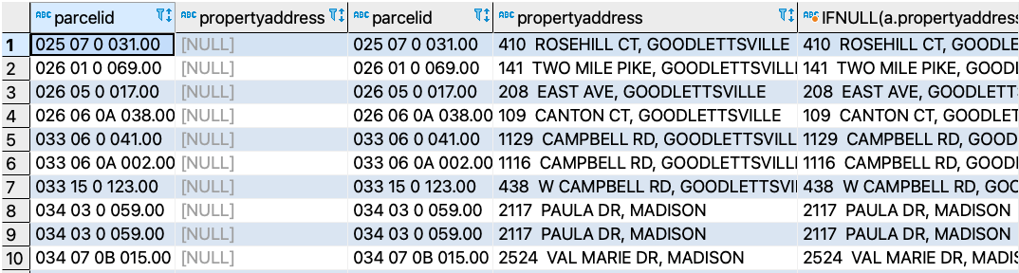
Result

Slide 11
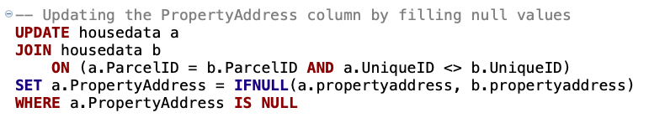
Solution

Slide 12
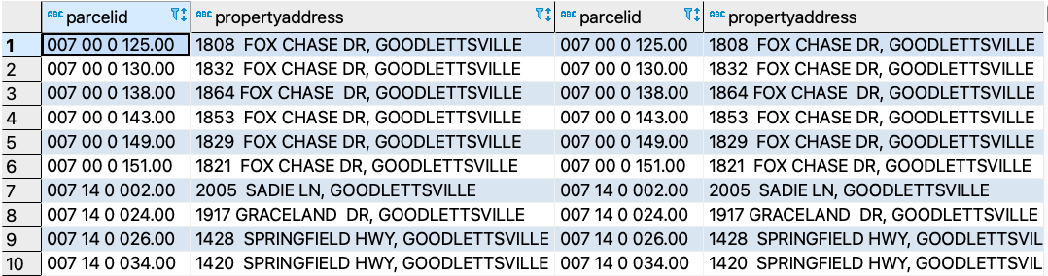
Result

Slide 13
3. Breaking Out “Property Address” And “Owner Address” Columns
Notes:
Issue: Breaking out the “Property Address” into two columns: Address and city
Breaking out ”Owner Address” columns into three: address, city, state

Slide 14
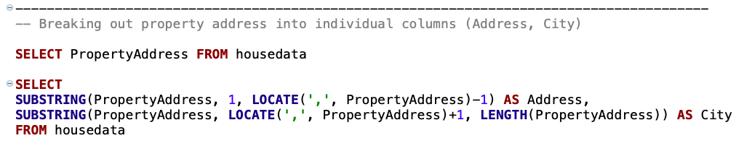
Solution – PropertyAddress

Slide 15
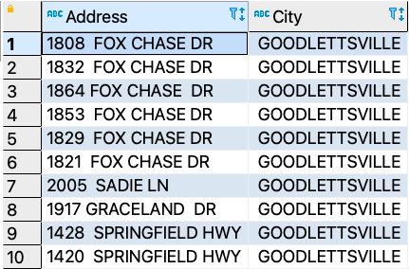
Result - PropertyAddress

Slide 16
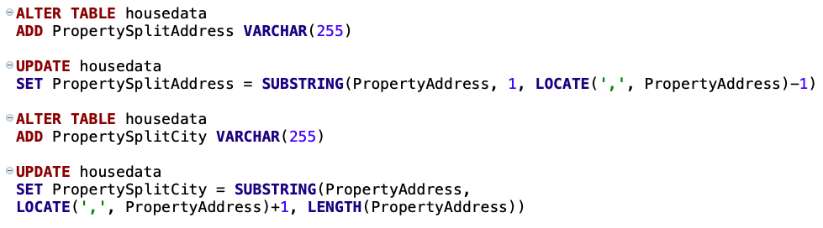
Solution – PropertyAddress

Slide 17
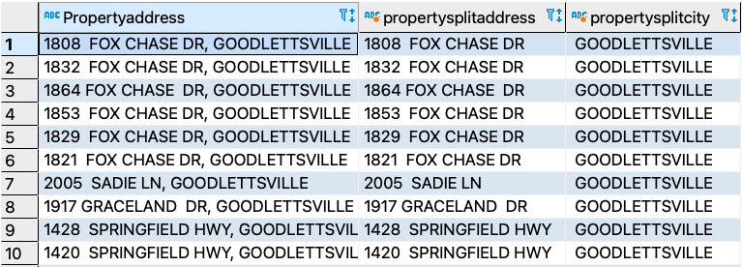
Result - PropertyAddress

Slide 18
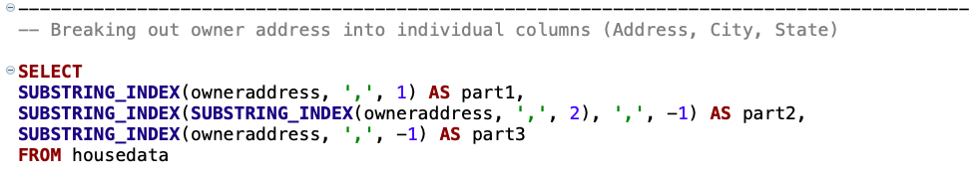
Solution – OwnerAddress

Slide 19
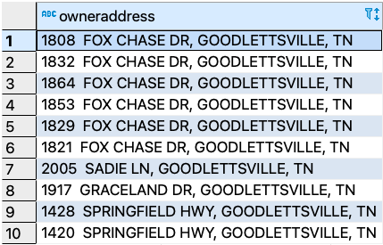
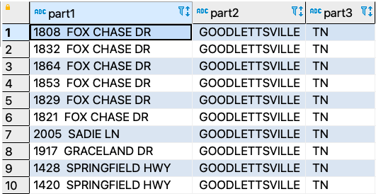
Result - OwnerAddress
Before
After

Slide 20

4. Replace “Y” And “No” In “Sold As Vacant” Column
Notes:
Issue: “Sold As Vacant” contains a mix of Y, N, Yes, No. I want all the Ys and Ns to be replaced by Yes and No

Slide 21
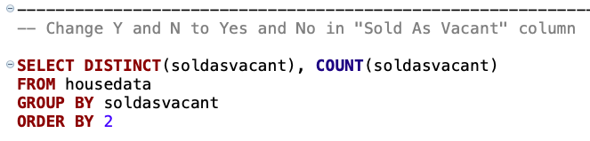
Solution

Slide 22
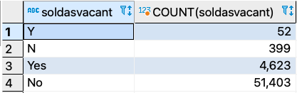
Result

Slide 23
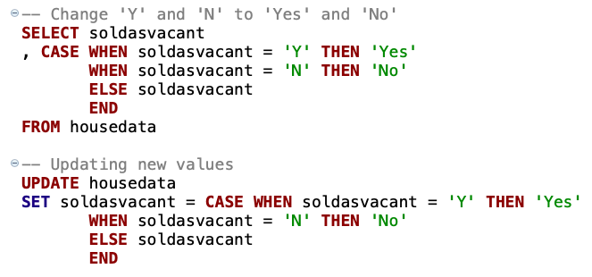
Solution

Slide 24

Result

Slide 25
5. Remove Duplicate records
Notes:
Issue: Some records are there more than once. I will therefore remove these duplicates.

Slide 26
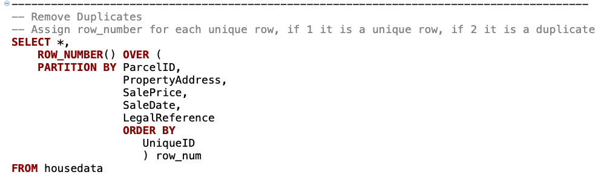
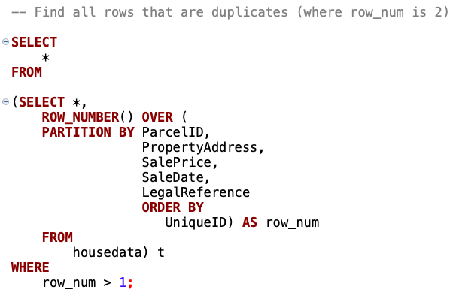
Solution

Slide 27
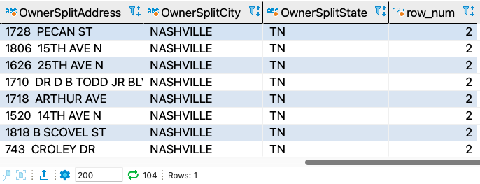
Result
104 Duplicates

Slide 28
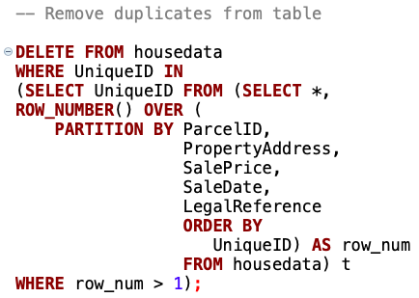
Solution

Slide 29
6. Remove / Delete Unused Columns
Notes:
Issue: Delete unused columns not relevant for further analysis. OwnerAddress, PropertyAddress, TaxDistrict (Remember we split OwnerAddress and PropertyAddress already)

Slide 30
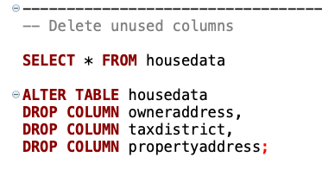
Solution

Slide 31



Thank You!

